Slide 1


Vegetable Market Analysis
Official Website- https://vegetablemarketprice.com/

Slide 2





Ayush Srivastava
pd19_114
Anand Shankar
pd19_029
OUR
TEAM
Pushpawati
pd19_104
Manish Rai
pd17_109

Slide 3
OUR TIMELINE
Web API
Json Conversion
Dataframe retrival
Successful extraction of data
Searching the Api of Vegetable market
Transformation of Api data to Json format
Final extraction of data in CSV format

Slide 4
END TIMELINE
Vegetable Basket formation
Price Analysis
Case Study
Successful completion of project
Monthly price analysis in Noida and nearby market
Basket formation for various Income group
Study on Quick Commerce Vegetable Business in Delhi

Slide 5
Average monthly price of each vegetable in the Noida Vegetable Market
Row Labels | Average of Avg Retail Price
Amaranth Leaves | 21.00930233
Amla | 100.2848837
Ash gourd | 40.93604651
Baby Corn | 105.7593023
Banana Flower | 29.03023256
Beetroot | 64.11744186
Bitter Gourd | 56.90581395
Bottle Gourd | 44.94767442
Brinjal | 45.56860465
Brinjal (Big) | 53.43372093
Broad Beans | 67.8627907
Butter Beans | 115.6046512
Cabbage | 40.67790698
Capsicum | 68.79651163
Carrot | 78.16162791
Cauliflower | 53.16511628
Cluster beans | 79.05465116
Coconut | 52.05348837
Colocasia | 45.08139535
Colocasia Leaves | 23.02209302
Coriander Leaves | 16.03372093
Corn | 46.94418605
Cucumber | 35.3
Curry Leaves | 56.23488372
Dill Leaves | 22.54418605
Drumsticks | 145.2290698
Elephant Yam | 47.89186047
Fenugreek Leaves | 18.19186047
French Beans | 79.61744186
Garlic | 104.8372093
Ginger | 72.70930233
Green Chilli | 67.9127907
Green Peas | 127.872093
Ivy Gourd | 47.41976744
Ladies Finger | 57.91395349
Lemon (Lime) | 98.64186047
Mango Raw | 133.4523256
Mint Leaves | 10.57674419
Mushroom | 146.7709302
Mustard Leaves | 28.71395349
Onion Big | 45.87906977
Onion Green | 72.39534884
Onion Small | 72.35581395
Potato | 51.7372093
Pumpkin | 44.03372093
Radish | 44.95697674
Raw Banana (Plantain) | 15.03372093
Ridge Gourd | 50.43372093
Shallot (Pearl Onion) | 59.13023256
Snake Gourd | 47.38139535
Sorrel Leaves | 21.15930233
Spinach | 23.11046512
Sweet Potato | 69.70581395
Tomato | 48.94418605

Slide 6
Comparison between Noida Vegetable market and Local Vegetable Market
Row Labels | Average of Avg shopping Mall Price | Average of Avg Retail Price
Mint Leaves | 11.85232558 | 10.57674419
Raw Banana (Plantain) | 16.9755814 | 15.03372093
Coriander Leaves | 18.06511628 | 16.03372093
Fenugreek Leaves | 20.73372093 | 18.19186047
Sorrel Leaves | 23.61395349 | 21.15930233
Amaranth Leaves | 23.94534884 | 21.00930233
Dill Leaves | 25.4755814 | 22.54418605
Colocasia Leaves | 25.99302326 | 23.02209302
Spinach | 26.0627907 | 23.11046512
Mustard Leaves | 32.43604651 | 28.71395349
Banana Flower | 32.81511628 | 29.03023256
Cucumber | 40.13837209 | 35.3
Cabbage | 46.21162791 | 40.67790698
Ash gourd | 46.42906977 | 40.93604651
Pumpkin | 49.9755814 | 44.03372093
Bottle Gourd | 51.01744186 | 44.94767442
Radish | 51.0872093 | 44.95697674
Colocasia | 51.26744186 | 45.08139535
Brinjal | 51.72674419 | 45.56860465
Onion Big | 52.08255814 | 45.87906977
Corn | 53.26744186 | 46.94418605
Snake Gourd | 53.77093023 | 47.38139535
Ivy Gourd | 53.80697674 | 47.41976744
Elephant Yam | 54.37325581 | 47.89186047
Tomato | 55.50348837 | 48.94418605
Ridge Gourd | 57.24186047 | 50.43372093
Potato | 58.71511628 | 51.7372093
Coconut | 59.00116279 | 52.05348837
Cauliflower | 60.29069767 | 53.16511628
Brinjal (Big) | 60.70465116 | 53.43372093
Curry Leaves | 63.72906977 | 56.23488372
Bitter Gourd | 64.50116279 | 56.90581395
Ladies Finger | 65.66046512 | 57.91395349
Shallot (Pearl Onion) | 66.95581395 | 59.13023256
Beetroot | 72.75348837 | 64.11744186
Broad Beans | 76.94767442 | 67.8627907
Green Chilli | 76.95813953 | 67.9127907
Capsicum | 78.05813953 | 68.79651163
Sweet Potato | 78.96046512 | 69.70581395
Onion Small | 82.03372093 | 72.35581395
Onion Green | 82.08255814 | 72.39534884
Ginger | 82.45930233 | 72.70930233
Carrot | 88.60930233 | 78.16162791
Cluster beans | 89.66511628 | 79.05465116
French Beans | 90.29767442 | 79.61744186
Lemon (Lime) | 111.8511628 | 98.64186047
Amla | 113.4616279 | 100.2848837
Garlic | 118.9337209 | 104.8372093
Baby Corn | 119.9930233 | 105.7593023
Butter Beans | 131.1290698 | 115.6046512
Green Peas | 145.0313953 | 127.872093
Mango Raw | 151.405814 | 133.4523256
Drumsticks | 164.6 | 145.2290698
Mushroom | 166.5744186 | 146.7709302

Slide 7
Insights
From the above data we can see that the Avg Market price of Shopping malls is always more than that of the Avg Retail price.
The main reason behind the price difference is assumed to be maintenance cost, which is always higher as compared to nearby market price.
In seasonal goods we can hardly see any price difference in the above graph.
Bargaining- In the Nearby Market generally bargaining is possible where as in the Noida Market people do not generally bargain which can create a huge difference in price.

Slide 8
TREND ANALYSIS

Slide 9
Mint Leaves | 11.85232558
Raw Banana | 16.9755814
Coriander Leaves | 18.06511628
Fenugreek Leaves | 20.73372093
Sorrel Leaves | 23.61395349
Amaranth Leaves | 23.94534884
Dill Leaves | 25.4755814
Colocasia Leaves | 25.99302326
Spinach | 26.0627907
Mustard Leaves | 32.43604651
Banana Flower | 32.81511628
Cucumber | 40.13837209
Cabbage | 46.21162791
Ash gourd | 46.42906977
Pumpkin | 49.9755814
Bottle Gourd | 51.01744186
Radish | 51.0872093
Seasonal vegetables in Noida Vegetable Market
Colocasia | 51.26744186
Brinjal | 51.72674419
Onion Big | 52.08255814
Corn | 53.26744186
Snake Gourd | 53.77093023
Ivy Gourd | 53.80697674
Elephant Yam | 54.37325581
Tomato | 55.50348837
Ridge Gourd | 57.24186047
Potato | 58.71511628
Coconut | 59.00116279
Cauliflower | 60.29069767
Brinjal (Big) | 60.70465116
Curry Leaves | 63.72906977
Bitter Gourd | 64.50116279
Ladies Finger | 65.66046512
Shallot | 66.95581395

Slide 10
Mint Leaves | 10.57674419
Raw Banana | 15.03372093
Coriander Leaves | 16.03372093
Fenugreek Leaves | 18.19186047
Sorrel Leaves | 21.15930233
Amaranth Leaves | 21.00930233
Dill Leaves | 22.54418605
Colocasia Leaves | 23.02209302
Spinach | 23.11046512
Mustard Leaves | 28.71395349
Banana Flower | 29.03023256
Cucumber | 35.3
Cabbage | 40.67790698
Ash gourd | 40.93604651
Pumpkin | 44.03372093
Bottle Gourd | 44.94767442
Radish | 44.95697674
Seasonal vegetables in nearby Vegetable Market
Colocasia | 45.08139535
Brinjal | 45.56860465
Onion Big | 45.87906977
Corn | 46.94418605
Snake Gourd | 47.38139535
Ivy Gourd | 47.41976744
Elephant Yam | 47.89186047
Tomato | 48.94418605
Ridge Gourd | 50.43372093
Potato | 51.7372093
Coconut | 52.05348837
Cauliflower | 53.16511628
Brinjal (Big) | 53.43372093
Curry Leaves | 56.23488372
Bitter Gourd | 56.90581395
Ladies Finger | 57.91395349
Shallot (Pearl Onion) | 59.13023256

Slide 11
Vegetable Basket

Slide 12
1
Summers
 |  | Low-income Group |  |  | Middle-income Group |  |  | High-Income Group
 |  | Vegetable | Price |  | Vegetable | Price |  | Vegetable | Price
 | Seasonal Vegetable | Bottle gourd | 40.93604651 |  | Ladies Finger | 57.91395349 |  | Ladies Finger | 65.66046512
 |  | Pumkin | 44.03372093 |  | Pumkin | 49.9755814 |  | Drumsticks | 164.6
 | Non-Seasonal Vegetable | Brinjal | 45.56860465 |  | Cabbage | 46.21162791 |  | Mushroom | 166.5744186
 | Others | Potato | 51.7372093 |  | Potato | 58.71511628 |  | Potato | 58.71511628
 |  | Onion | 72.35581395 |  | Onion | 82.03372093 |  | Onion | 82.03372093
 |  | Coriander Leaves | 16.03372093 |  | Coriander Leaves | 16.03372093 |  | Coriander Leaves | 18.06511628
 |  | Green Chilli | 67.9127907 |  | Green Chilli | 76.95813953 |  | Green Chilli | 76.95813953
 |  | Tomato | 48.94418605 |  | Tomato | 55.50348837 |  | Tomato | 55.50348837
 |  | Total | 387.522093 |  | Cucumber | 35.3 |  | Cucumber | 40.13837209
 |  |  |  |  | Garlic | 104.8372093 |  | Garlic | 118.9337209
 |  |  |  |  | Total | 583.4825581 |  | Lemon (Lime) | 111.8511628
 |  |  |  |  |  |  |  | Total | 959.0337209

Slide 13
2
Spring
 |  | Low-income Group |  |  | Medium-income Group |  |  | High-income Group
 |  | Vegetable | Price |  | Vegetable | Price |  | Vegetable | Price
 | Seasonal Vegetable | Brinjal | 45.56860465 |  | Capsicum | 68.79651163 |  | Capsicum | 78.05813953
 |  | Cauliflower | 53.16511628 |  | Ivy Gourd | 53.80697674 |  | French Beans | 90.29767442
 | Non-Seasonal Vegetable | Bitter Gourd | 56.90581395 |  | Sweet Potato | 69.70581395 |  | Baby Corn | 119.9930233
 | Others | Potato | 51.7372093 |  | Potato | 58.71511628 |  | Potato | 58.71511628
 |  | Onion | 72.35581395 |  | Onion | 82.03372093 |  | Onion | 82.03372093
 |  | Coriander Leaves | 16.03372093 |  | Coriander Leaves | 16.03372093 |  | Coriander Leaves | 18.06511628
 |  | Green Chilli | 67.9127907 |  | Green Chilli | 76.95813953 |  | Green Chilli | 76.95813953
 |  | Tomato | 48.94418605 |  | Tomato | 55.50348837 |  | Tomato | 55.50348837
 |  | Total | 412.6232558 |  | Garlic | 104.8372093 |  | Garlic | 118.9337209
 |  |  |  |  | Total | 586.3906977 |  | Lemon(Lime) | 111.8511628
 |  |  |  |  |  |  |  | Total | 810.4093023

Slide 14
3
Winters
 |  | Low-income Group |  |  | Medium-income Group |  |  | High-income Group
 |  | Vegetable | Price |  | Vegetable | Price |  | Vegetable | Price
 | Seasonal Vegetable | Cabbage | 40.67790698 |  | Spinach | 23.11046512 |  | Spinach | 26.0627907
 |  | Couliflower | 53.16511628 |  | Cabbage | 46.21162791 |  | Broad Beans | 76.94767442
 | Non-Seasonal Vegetable | Ridge Gourd | 50.43372093 |  | Coconut | 52.05348837 |  | Ladies Finger | 65.66046512
 | Others | Potato | 51.7372093 |  | Potato | 58.71511628 |  | Potato | 58.71511628
 |  | Onion | 72.35581395 |  | Onion | 82.03372093 |  | Onion | 82.03372093
 |  | Coriander Leaves | 16.03372093 |  | Coriander Leaves | 16.03372093 |  | Coriander Leaves | 18.06511628
 |  | Green Chilli | 67.9127907 |  | Green Chilli | 76.95813953 |  | Green Chilli | 76.95813953
 |  | Tomato | 48.94418605 |  | Tomato | 55.50348837 |  | Tomato | 55.50348837
 |  | Total | 401.2604651 |  | Green Peas | 127.872093 |  | Green Peas | 145.0313953
 |  |  |  |  | Carrot | 78.16162791 |  | Carrot | 88.60930233
 |  |  |  |  | Raddish | 44.95697674 |  | Raddish | 51.0872093
 |  |  |  |  | Garlic | 51.0872093 |  | Garlic | 118.9337209
 |  |  |  |  | Total | 712.6976744 |  | Amla | 113.4616279
 |  |  |  |  |  |  |  | Lemon (Lime) | 111.8511628
 |  |  |  |  |  |  |  | Total | 1088.92093

Slide 15
Inflation Rate
Low-Income Group Avg= 400.46
Middle-Income Group= 627.52
High-Income Group= 952.78
AVG of all Income Groups Combined= 660.25
Inflation for Low-Income Group=(627.52-400.46)/627.52 X 100= 36.18%
Inflation for Middle-Income Group= (952.78-627.52)/952.78 X 100= 34.13%
Inflation for High-Income Group= (952.78-660.25)/660.25 X 100= 44.30%

Slide 16
1
The market size & potential for the quick commerce vegetable business in Delhi is significantly high, Considering the population of Delhi to be over 18 million. In addition to it, the government is also acting as a helping hand to these start-ups by introducing initiatives such as Digital India and Start-Up India have created a favourable environment for the growth of the business itself as well as the Nation. With the steep increase in smartphone penetration, seamless internet connectivity and ease of lifestyle more and more people in Delhi are turning to online quick commerce vegetable business for their convenience and quality products. As a result, there is a tremendous opportunity for entrepreneurs to enter this space and capture a significant share of the market.
CASE STUDY
The market size and potential for the quick commerce vegetable business in Delhi

Slide 17






2
Big basket
Blinkit
Amazon fresh
Our Competitors
Swiggy Instamart
Flipkart Supermarket
Zepto

Slide 18
There are big giants like BigBasket, Amazon Fresh, Flipkart Supermarket, BlinkIt, Zepto, and SwiggyInstamart. To compete in this crowded market and such big giants, quick commerce vegetable businesses need to differentiate themselves from each other through their pricing, customer service and product offerings. The competition who will offer high-quality products, excellent customer service, competitive pricing and fast delivery are likely to gain a large market share and succeed rapidly in this space. Additionally, businesses can leverage technology to improve their operations, such as using data analytics to optimise inventory management and delivery routes
Competitive landscape
What is the competitive landscape for the quick commerce vegetable business in Delhi?

Slide 19
3
Competition
KEY CHALLENGES
The quick commerce vegetable businesses in Delhi is highly competitive, with several giants trying to take over the market. Businesses need to differentiate themselves through their product offerings, pricing and customer satisfaction

Slide 20
Sourcing high-quality vegetables
Payment Collection
Managing Inventory
Collecting timely payments from customers can be challenging, especially where cash-on-delivery is prevalent. Businesses need to have a robust payment collection system in place to ensure timely payment collection and prevent payment defaults.
Managing Inventory can be another challenge that can be faced by the quick commerce vegetable business. They need to ensure that they have sufficient stock of all vegetables, while also managing that they don’t have excess stock that may go to waste
One of the main challenges faced by the quick commerce vegetable businesses is of sourcing high-quality vegetables. The quality of the vegetables can significantly impact customer satisfaction, the business must ensure that they are sourcing fresh and high-quality products
Sourcing high-quality vegetables
Infrastructure Challenges
Ensuring Timely Delivery
One of the main challenges faced by the quick commerce vegetable businesses is of sourcing high-quality vegetables. The quality of the vegetables can significantly impact customer satisfaction, the business must ensure that they are sourcing fresh and high-quality products.
Delhi faces several infrastructure challenges such as traffic congestion and poor road condition in places, which can impact the delivery times and logistics of the quick commerce vegetable business
Timely Delivery plays a very important role in the success of quick commerce vegetable businesses. Customers expect their orders to be delivered promptly, and any delays can lead to dissatisfaction and loss of customers.

Slide 21
High-quality products
4
Competitive pricing
Success
Factors
Efficient logistics and delivery
Innovative technology
Customer service
Brand image

Slide 22
High-quality products
Competitive pricing
Efficient logistics and delivery
Innovative technology
Quick commerce vegetable businesses need to source and deliver high-quality vegetables to their customers consistently.
Need to offer competitive prices to attract and retain customers, while also ensuring that their profit margins are healthy.
Need to ensure that they can deliver products promptly and reliably, while also managing inventory and minimizing wastage.
Quick commerce vegetable businesses can leverage innovative technology to streamline their operations and improve efficiency.

Slide 23
Customer service
Brand image
Need to provide excellent customer service to ensure customer satisfaction and loyalty. This includes timely resolution of customer queries and complaints, as well as efficient handling of returns and refunds.
Building a strong brand image is critical for the success of quick commerce vegetable businesses. They need to establish themselves as a reliable and trustworthy brand that offers high-quality products, competitive prices, and excellent customer service.

Slide 24




How can the quick commerce vegetable business in Delhi leverage technology to improve their operations and customer experience
5
Technology
And
Operations
100
90
80
70
60
50
40
30
20
10
One
Two
Three

Slide 25

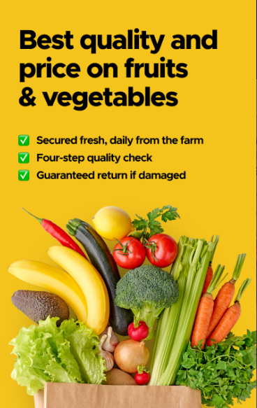


PHONE PREVIEW SAMPLE
Quick commerce vegetable businesses can develop mobile, tablet and laptop applications that allow customers to browse products, place orders, and track deliveries. This can improve the customer experience by making it more convenient for customers to shop and receive their orders.

Slide 26

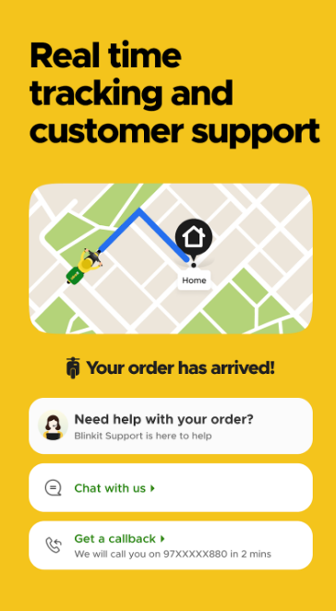

LAPTOP PREVIEW SAMPLE

Slide 27
Data analysis
Quick commerce vegetable businesses can use data analytics to optimize their operations. For example, they can analyze data on customer preferences and buying patterns to optimize their inventory management and supply chain.
100
90
80
70
60
50
40
30
20
10
One
Two
Three

Slide 28
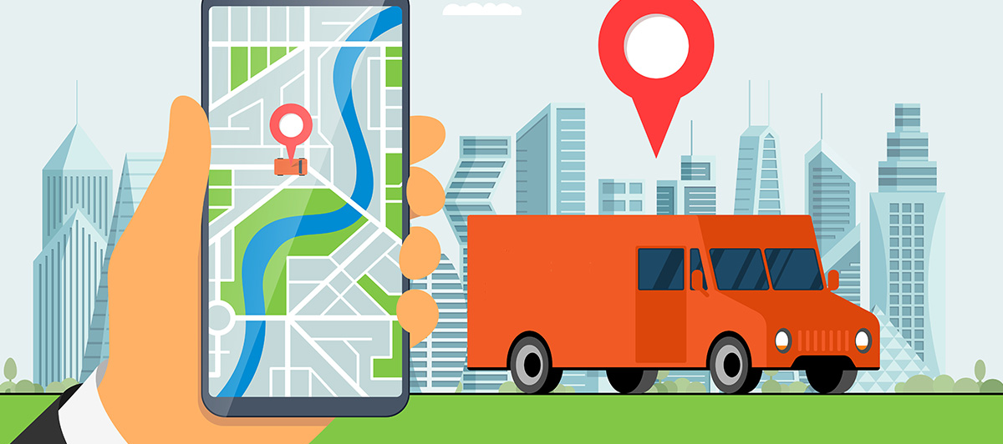
GPS tracking
GPS tracking technology can be used to track delivery vehicles and optimize delivery routes. This can improve delivery times and reduce transportation costs.

Slide 29
Automated Inventory Management
Automated inventory management systems can help quick commerce vegetable businesses manage their inventory more efficiently. These systems can track inventory levels, predict demand, and generate alerts when inventory levels fall below a certain threshold.

Slide 30
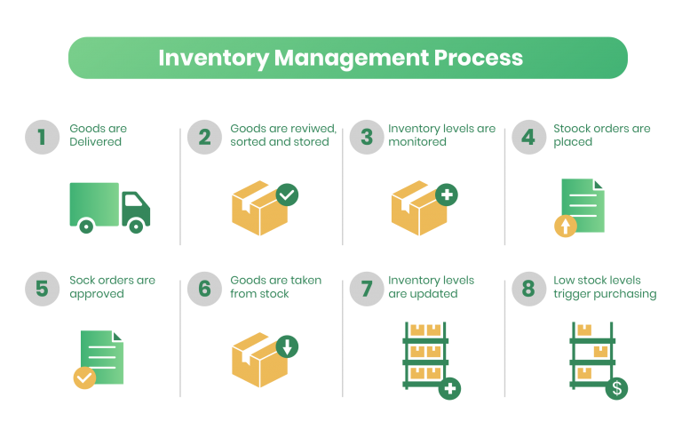

Slide 31

Electronic payment systems
Electronic payment systems, such as mobile wallets and online payment gateways, can make it easier for customers to pay for their orders. This can improve the customer experience by reducing the need for cash transactions.

Slide 32
THANK YOU

